Slide 1


The Battle Of Neighbourhoods
IBM Coursera capstone project
By – Astha c

Slide 2

Contents
Introduction
Methodology
Description of Data
Results
Discussion
Conclusion

Slide 3
Introduction – Background to Business Problem
Problem Statement: Prospects of a Lunch Eating Joint close to College Areas in Tokyo, Japan.
Tokyo is one of the most populous metropolitan cities in the world. Currently ranked in the top 5 of global economic power index. So, this makes Tokyo as one of the best places to start with a new business opportunity.
During the daytime, especially in the morning and during the lunch hours, campus areas around colleges provide huge opportunities for Eating joints business. Reasonably priced shops are usually always full during the breakfast and lunch hours (11 am - 3 pm) and, given this scenario, we will go through the pros and cons of opening a breakfast cum lunch eating joint in highly dense college places. Usually the profit margin for a decent food joint lies within 15−20% range but, it can be higher, as we will be discussing here more in detail. The core of Tokyo is made of 23 wards (municipalities) but, will be later choosing the 6 busy business wards of Tokyo — 'Odaiba','Shinjuku','Kinshicho','Shinagawa','Shibuya','Ikebukuro', to target the college students.
Target Audience
Business personnel’s who want to invest in a business or open a restaurant. This analysis will be a comprehensive guide to start or expand restaurants targeting the large pool of students in Tokyo during lunch hours.
Freelancers who love to open their own restaurant as the side business. This analysis will give them an idea, how good it is to open a restaurant along with the pros and cons of this restaurant business.
New comers in the city/ Students/ Freshers, to find reasonable lunch/breakfast place closer to their colleges.
Students/ Professionals who are interested in Data Science and want to implement some of the most used Data Analysis methods to obtain necessary data, analyse it, and conclude it.

Slide 4
Description of Data
Scrapping Tokyo Wards Table from Wikipedia
Special Wards of Tokyo page from Wiki (https://en.wikipedia.org/wiki/Special_wards_of_Tokyo) is used to scrap the table to create a data-frame.
Getting Coordinates of the 1st Major Districts: Geopy Client
It captures the coordinates of these 1st major districts using geocoder class of Geopy client.
Average Land Price in Major Wards of Tokyo: Web Scrapping
Foursquare Location Data
Foursquare (https://developer.foursquare.com/) data is very comprehensive and it powers location data for Apple, Uber etc. For this business problem, Foursquare API is used to retrieve information about the popular spots around these 6 Major Districts of Tokyo.
Another web-page (https://utinokati.com/en/details/land-market-value/area/Tokyo/) would be used to scrap the table and capture the average the average land price of these Major districts in a dataframe. This factor will later help us in selecting the best districts to open a restaurant.

Slide 5
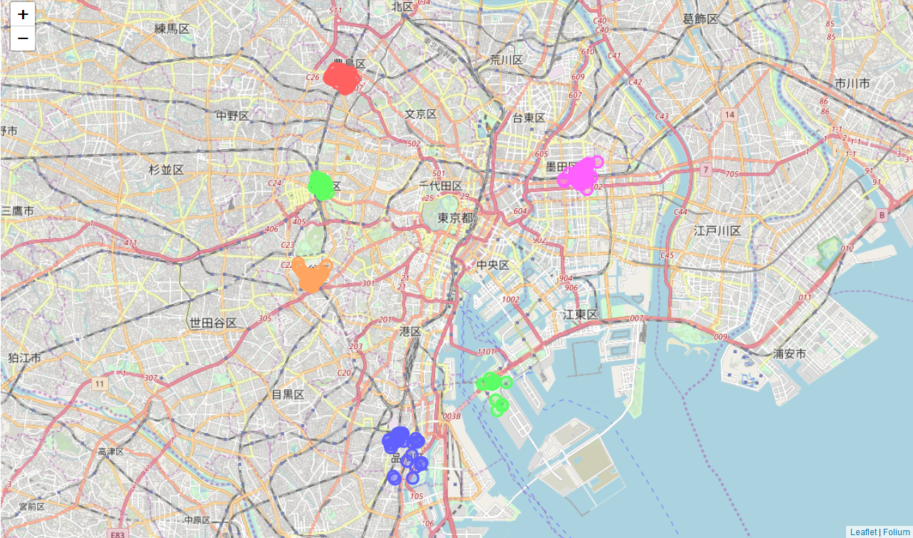
Methodology
1) Integrating data from multiple sources
2) Defining measuring metrics
3) Visualizing the findings
Wards in Tokyo
FourSquare Data
Average Land Price
New Restaurant Business Index
Land Price Data
Wards data
Frequently visited Restaurants

Slide 6
Methodology
Step 1 – Integrating data from multiple sources
This step is also known as data processing stage. Data is extracted from multiple sources and processed further in order to make it more meaningful and to complete the analysis. Here, data is extracted from web using web-scarping method and Foursquare data using API calls and further integrated to complete the analysis.
Step 2 – Defining measuring metrics
This is the main step of the analysis. Based on the data, as retrieved in Step 1, analysis is done. Here, the data is analysed based on the most frequently occurring venues, i.e. Coffee Shops and Restaurants in the 6 major districts (Odaiba, Shinjuku, Kinshicho, Shinagawa, Shibuya, Ikebukuro) of Tokyo.
Step 3 – Visualizing the findings
In this step, we are using Folium to develop a choropleth map and other bar graphs in order to visualize the findings and analysis.

Slide 7





Results
The results of The Battle of Neighbourhoods concluded with data-driven analysis and clustering, are summarized as below:
Except Odaiba, Ramen restaurants is present in top 5 position of most common venues in remaining of the 5 districts.
Coffee Shops in Odaiba, tops the most frequently visited in the food joints category with limited visits to the restaurants.
Ikebukuro district in Toshima ward is dominated by Japanese, Yoshoku & Ramen restaurants as the most common venues and Kinshicho district in Sumida ward is dominated by Ramen, Thai & Japanese restaurants
Shibuya area is dominated by bars, pubs, clubs and cafe as most common venues.
Kinshicho has maximum number of restaurants as the most common venue whereas has Odaiba area has the least. But, Coffee Shops and Cafe are found to be among the most visited destinations in this area.
Since the clustering was based only on the most common venues o each district, Odaiba, Shibuya fall under the same cluster and, Shinjuku, Kinshicho and Ikebukuro fall under another cluster. Shinagawa is separated from both clusters as; convenient stores stand out as the most common venue (with a very high frequency).

Slide 8
Discussion
According to this analysis, Odaiba followed by Shinagawa Districts will provide least competition for an upcoming lunch restaurant as the Convenience Store is the most common venue in these areas and the frequency of restaurants as common venue are very low compared to the remaining districts.
Also, as it can be seen from the web-scrapped data, the average land price in and around Shinagawa is much cheaper compared to Odaiba and other Districts close to central Tokyo. So, Shinagawa region could potentially be a most favourable deal to start with the restaurant business.
Some drawbacks of this analysis are-- the clustering is completely based on the most common venues obtained from Foursquare data. Since land price, distance of the venues from closest stations, number of potential customers, benefits and drawbacks of Shinagawa being a port region, could all play a major role and thus, the conclusion of this analysis could vary depending on other factors as well. However, it gives us some kick-start and important piece of information on the potentials of doing restaurant business in and around the major districts of Tokyo.
Conclusion
As a conclusion to this project, it gives us an over-all idea about the real-life data-science projects. Many frequently used python libraries have been used in this analysis like BeautifulSoup to scrap web-data into data-frames, Foursquare API to explore the major districts of Tokyo and saw the results of segmentation of districts using Folium leaflet map and other results using Bar graph. Analysis of this kind of real-life business problem is of great potential and brings a lot of scope for improvement in business related. Also, some of the drawbacks and chance for improvements to represent even more realistic pictures are mentioned. Finally, this analysis is mostly concentrating on the possibilities of opening a restaurant targeting the huge pool of students, freshers and new comers.

Slide 9

Thank You!

